Slide 1
Artificial Intelligence (CS303) Lab Courses
Lab 1: Introduction

Slide 2
Outline of this lab
Project Information of CS303
Course Requirements
Course Arrangement

Slide 3
Project Information of CS303
3 Projects, roughly:
The first 3 have 3 labs each
Phase inspection (阶段性检查)
Knowledge Involved
Problem Solving
Uncertain Knowledge and Reasoning
Machine Learning

Slide 4
Course Requirements
Students should have basic independent programming skills
Students should think deeply about algorithms and have the ability to apply algorithms and improve them.
All project reports must be written according to the report template.
Students should not copy other students’ codes or senior students’reports. Once found, you or both will get 0 points. Please think twice when you plan to share.

Slide 5
Course Arrangement
Explain the information for each project and share useful materials
Explain the realization of the main algorithm in the theoretical study
Collect common questions in projects and explain
Share design ideas, experience, etc

Slide 6
Programming Language
We Use Pythonin Our Project
- Easy Syntax, Readability, High-Level Language, object oriented programming, free, etc.
NumPy Package
fundamental package for scientific computing
It contains among other things:
a powerful N-dimensional array object
sophisticated (broadcasting) functions
tools for integrating C/C++ and Fortran code
useful linear algebra, Fourier transform, and random number capabilities
http://www.numpy.org/

Slide 7
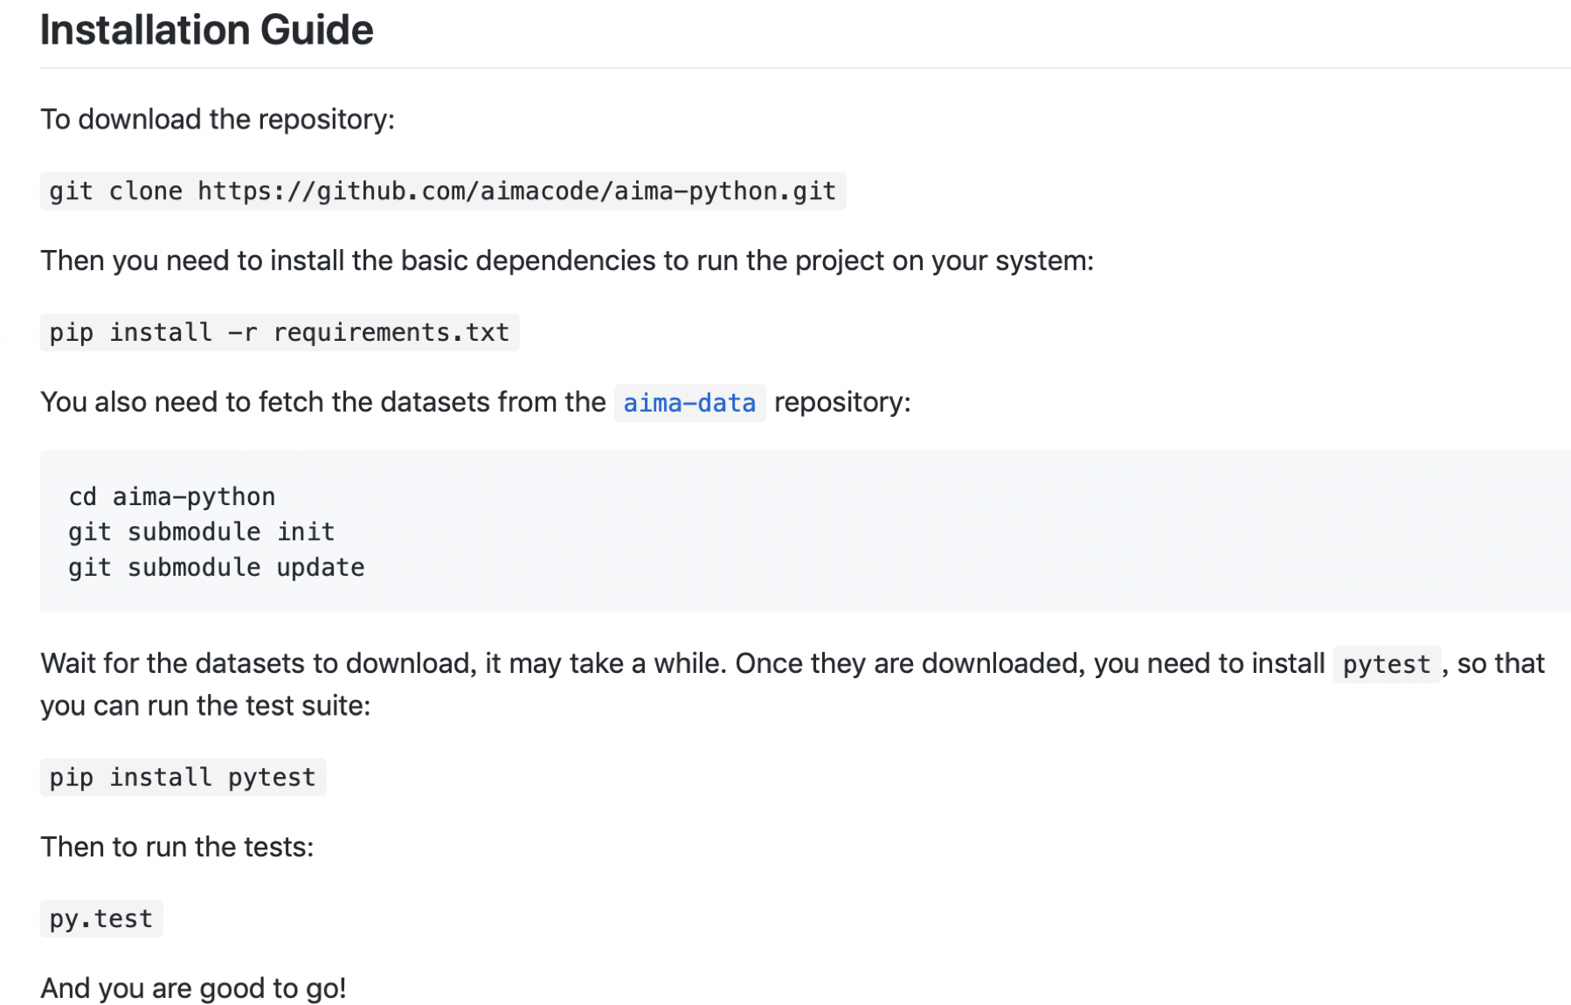
Course Website and Available Code
The website for this course: http://aima.cs.berkeley.edu
Relevant code available at : https://github.com/aimacode
support for multiple languages: python, java, javascript and so onA
aima-python Installation

Slide 8
Quick Start with Python
https://learnxinyminutes.com/docs/python3/
You can install python with anaconda which is a package manager
https://www.anaconda.com/download/
Python IDE: PyCharm
https://www.jetbrains.com/pycharm/download/#section=mac

Slide 9
Advice for Study
When you need to understand the knowledge points in the book, you can run the demo and read some related code.
Seriously do every project in the computer class
Ps: The lab topics in the computer class are the topics of the current frontiers of artificial intelligence. I hope everyone can think deeply.

Slide 10
Teaching Assistant
Rui He (和瑞), QQ: 838098315, her2018@mail.sustech.edu.cn
We will try our best to help you, but not about debugging, etc.

